Slide 1
PEER DESIGN REVIEW
Powered Dobsonian Telescope
Nathan Wiley
Submitted in partial fulfillment of the requirements of CST471
ESET Senior Project, Oregon Institute of Technology.

Slide 2
Agenda:
The Problem and Solution
Designs, Features, and Progress
Block Diagram
Part Selection
Calculations
Cost
Schedule

Slide 3
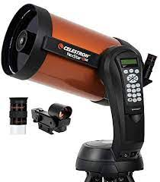
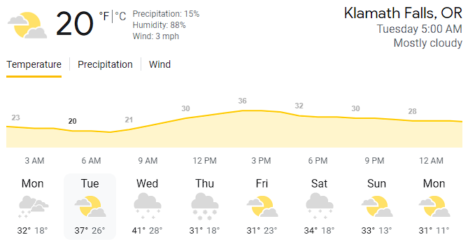
The Problem:
Telescopes are not automated enough!
Need to be present to punch in coordinates
Cold
Clunky
Outdated

Slide 4
The Solution:
Make a telescope that you can control from your couch!

Slide 5
Design & Features:
Requirements (Very condensed)
1. Shall pivot a telescope (accuracy to 3600 arcseconds / 1 degree)
2. Shall be able to keep accurate time
3. Shall use a control system
4. Shall have a network interface
5. Shall use a display
Stretch goals
1. May have a camera
2. May use RTC module
3. May include GPS module
4. May include Wi-Fi and Ethernet
5. May include cooling system

Slide 6
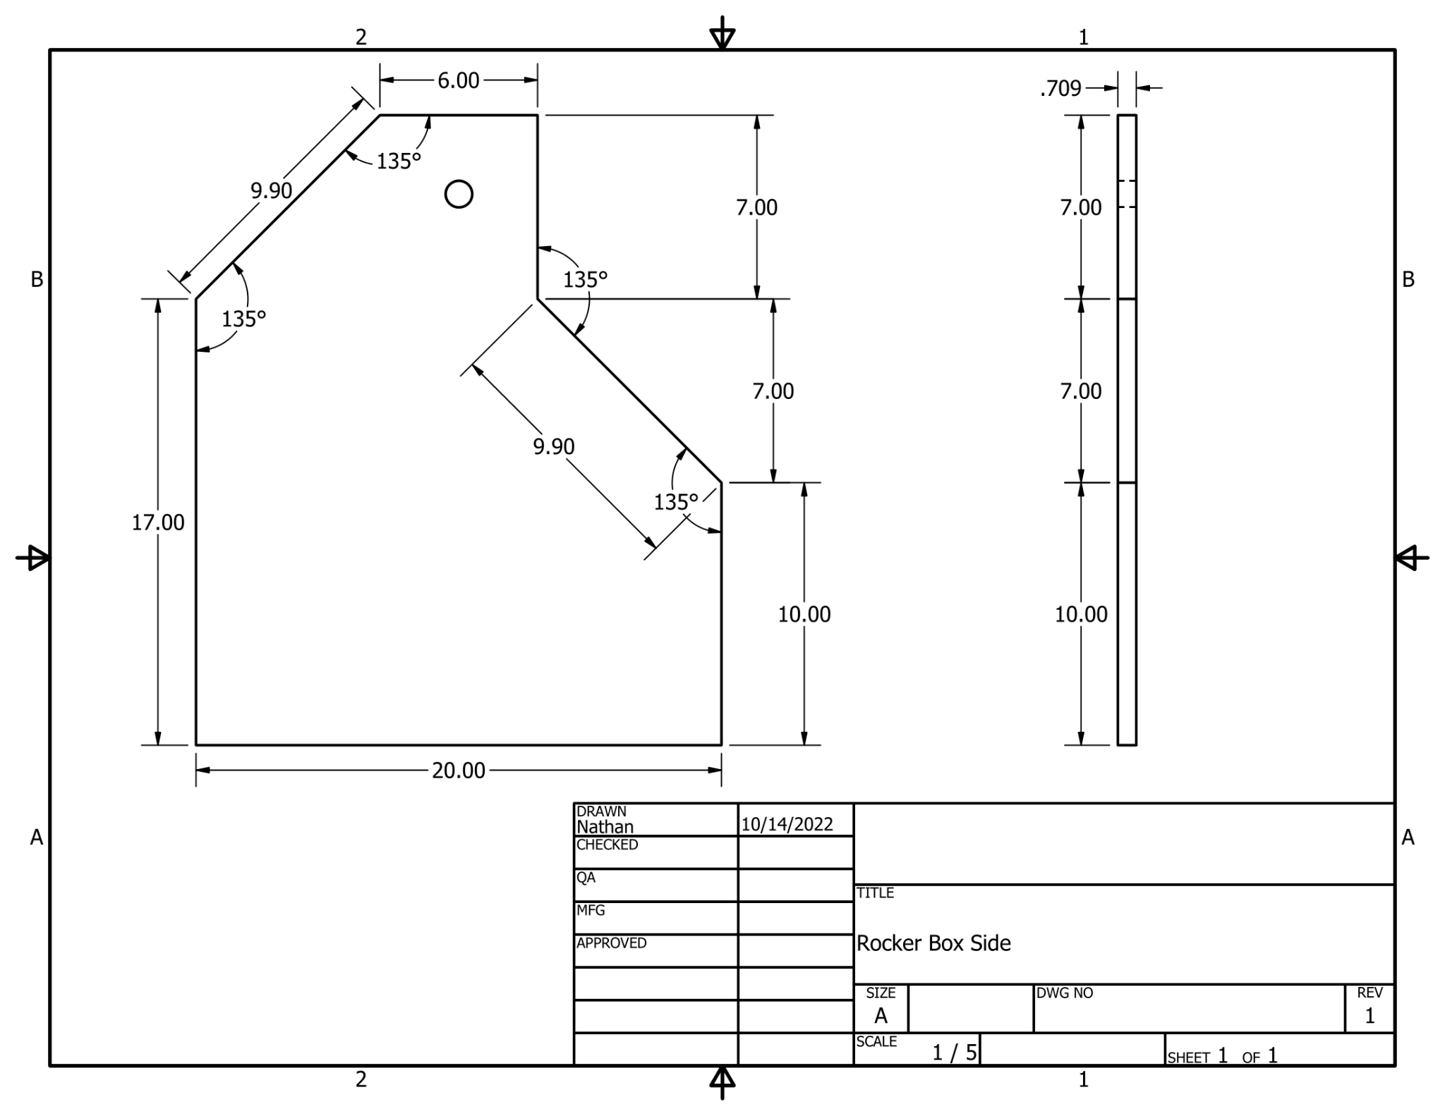
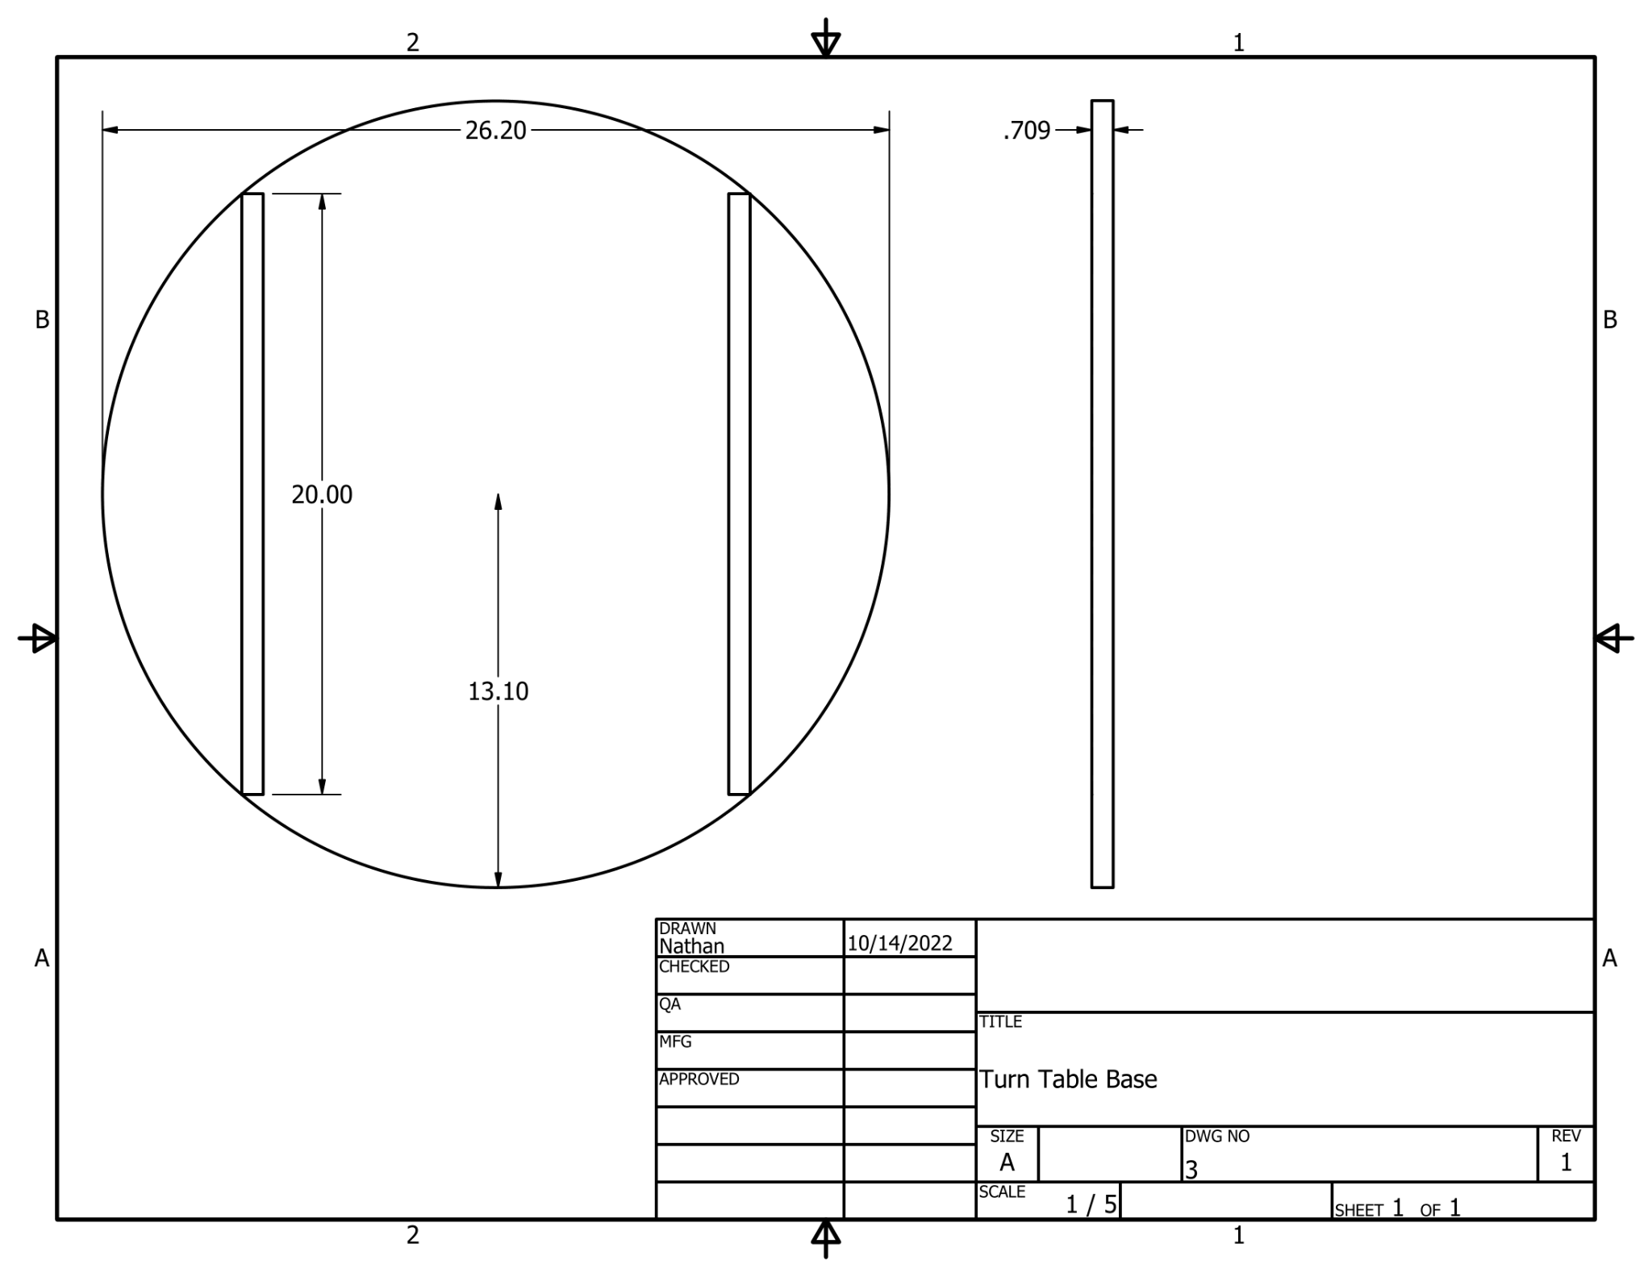
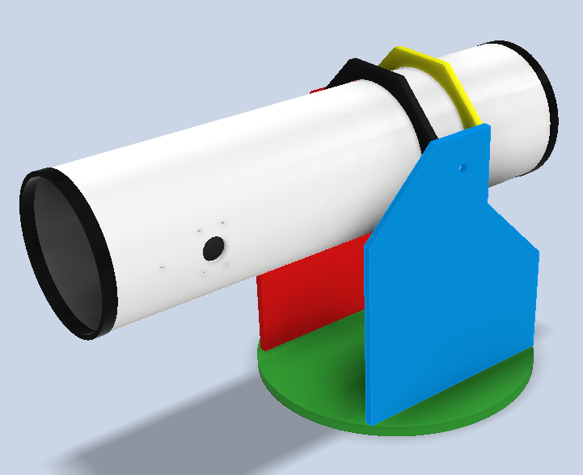
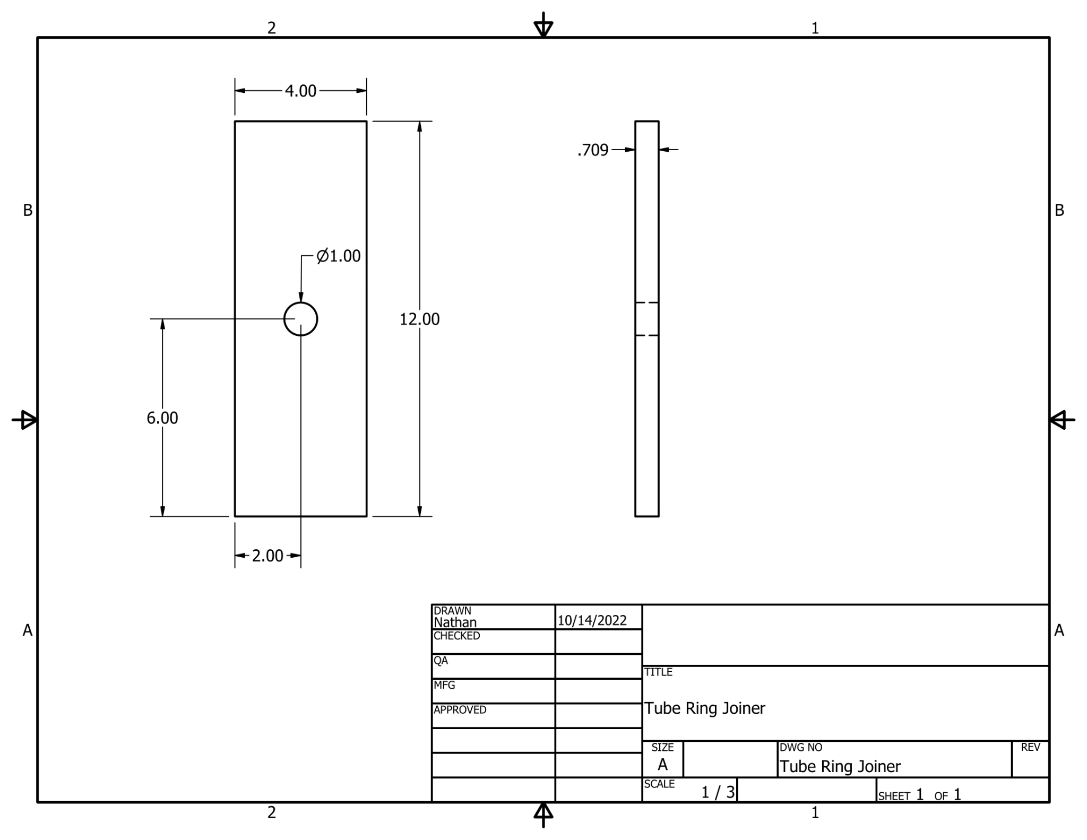
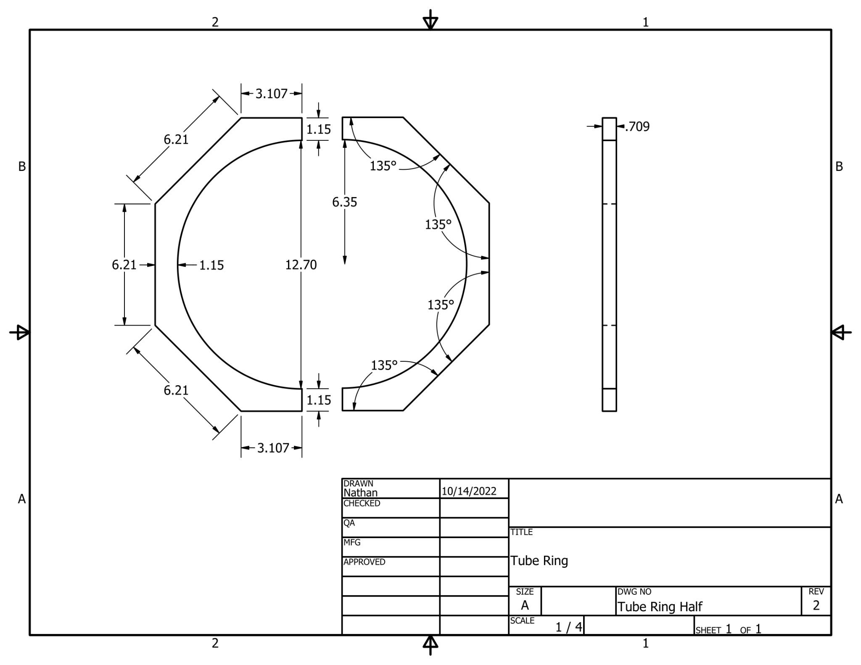
Design process and progress:

Slide 7
Block Diagram:
Camera
Raspberry PI
Stepper Driver
Vertical Motor
Client
Ethernet
Or Wifi
Stepper Driver
Horizontal Motor
Power supply

Slide 8
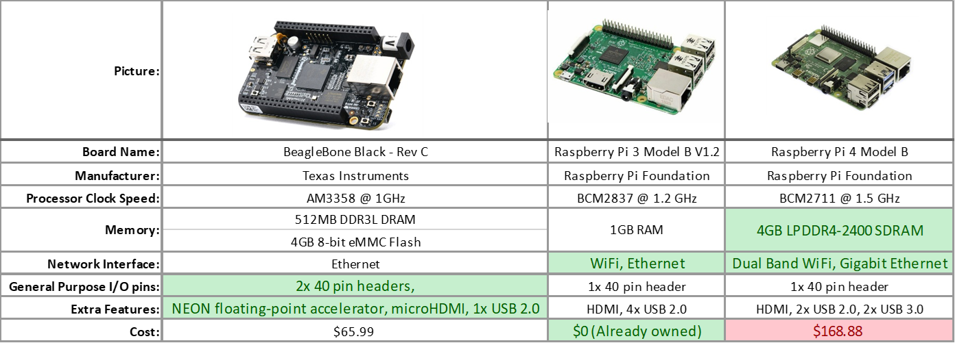
Part Selection: Board

Slide 9
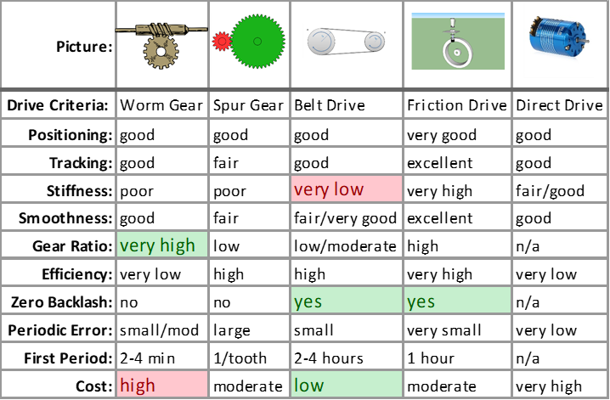
Part Selection: Gearing
DFM Engineering, Inc Engineering Article: Comparing Telescope Drive Technologies

Slide 10
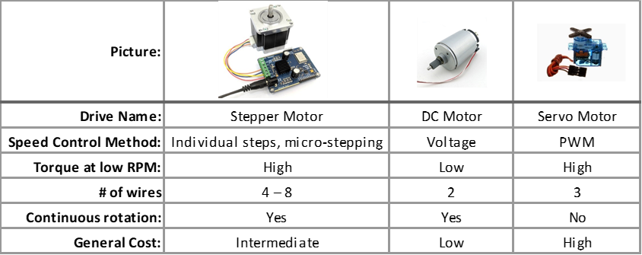
Part Selection: Motorization Type

Slide 11
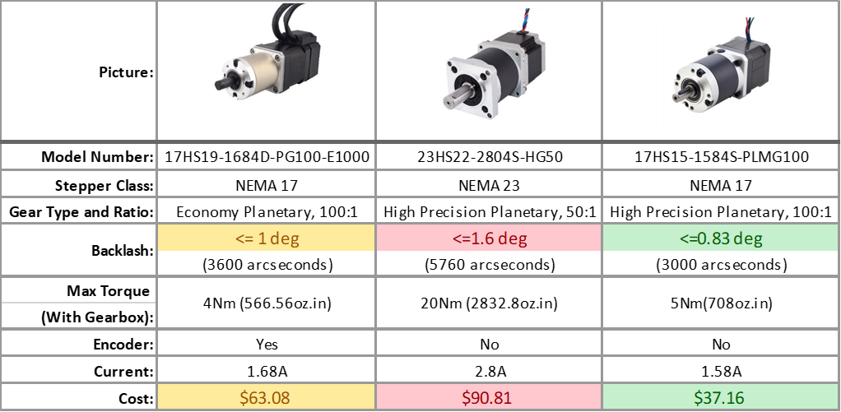
Part Selection: Motorization Type

Slide 12
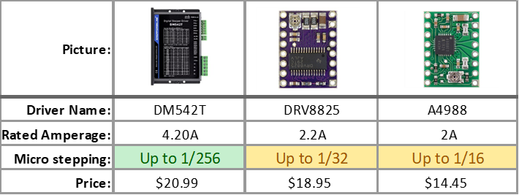
Part Selection: Stepper Motor Driver

Slide 13
Calculations:
1,296,000 arcseconds per 360 degrees, 1 revolution
Stepper motor has 200 steps per revolution, 1.8 degrees per step
100:1 Planetary gear input is attached to motor output
4:1 Belt drive input is attached to planetary gear output
1,296,000 / (200)*(100)*(4) = 16.2 arcseconds (0.0045°) per step
With microstepping it could be even higher precision!

Slide 14
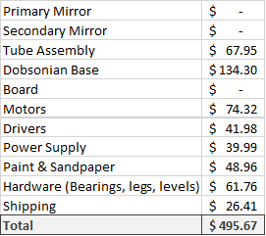
Cost:
Still Need:
Belt and pulley
Camera
Adjustable zoom eyepiece

Slide 15
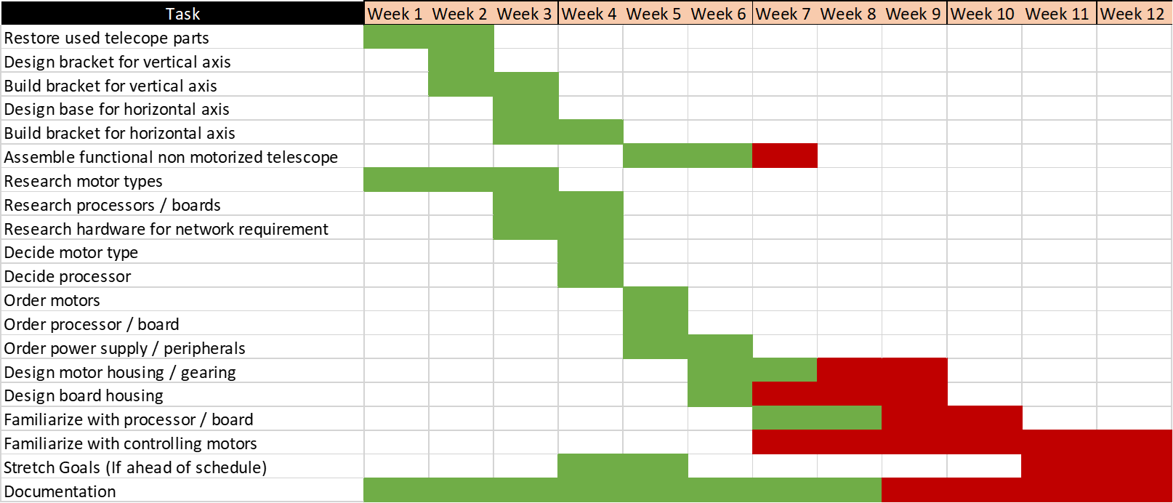
Schedule - Fall Term Chart

Slide 16
Schedule - Tasks for Fall Term
Done
Design Tube Rings
Build Tube Rings
Design Base
Build Base
Research motor types
Research processors
Decide motor type
Decide processor
Order motors
Order power supply
In progress
Finish non motorized telescope
Design motor housing
Design motor gearing
Familiarize with processor / board
Not Started
Familiarize with controlling motors

Slide 17
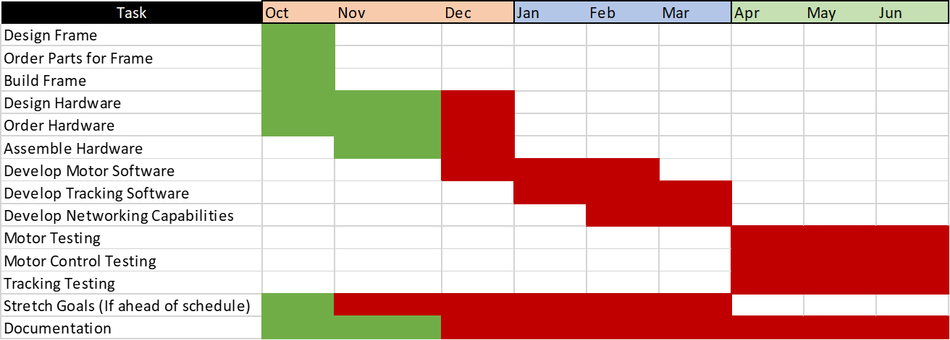
Broad Schedule:

Slide 18
Questions?

